Slide 1


transition UNITS THEORY
Cornelius J. Maxwell
General Director
Lorna René LLC

Slide 2
Agenda
Introduction
The Transition Environment
  Veteran Statistics
  Issues With The Current Transition Process
The Solution: Transition Units Theory
Funding and Budgeting
Marketing and Awareness

Slide 3
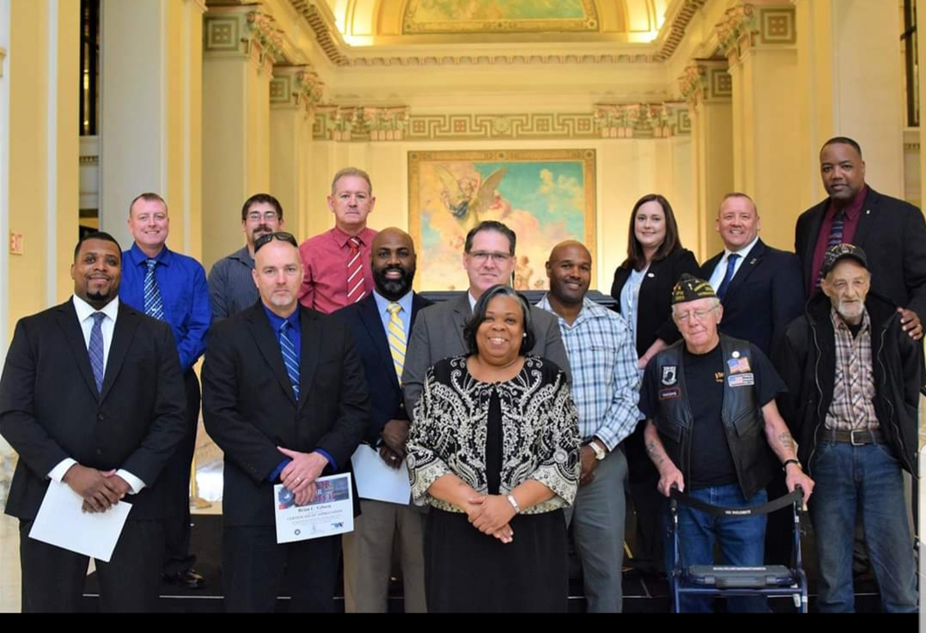
INTRODUCTION

Slide 4


MILITARY SERVICE
US Army
8 years - 2004-2012
3 combat deployments during OIF (Operation Iraqi Freedom)
Communications Sergeant

Slide 5



EDUCATION
Bachelor’s of Science in Political Science, University of Houston
Executive MBA Fellow, University of California Los Angeles
Masters in Business Administration in Project Management (Degree Candidate), Grand Canyon University

Slide 6



Veterans Service
Honor House (Board of Directors Member)
Wings For Warriors (Board of Directors Member)
Art Director for Lorna René LLC art exhibitions "Honor Our Heroes" series
  Goal = Honor 100K+ veterans
Creator of the "Transition Units Theory"

Slide 7






Veterans Service
Unified Arizona Veterans (UAV)
HB2093 12 More VBCs in AZ
City of Scottsdale Veteran Commission
City of Phoenix Stars and Stripes Memorial project
Veterans of Foreign Wars (Member)
Disabled American Veterans
American Legion (Member)

Slide 8
The transition environment

Slide 9

vet stats

Slide 10
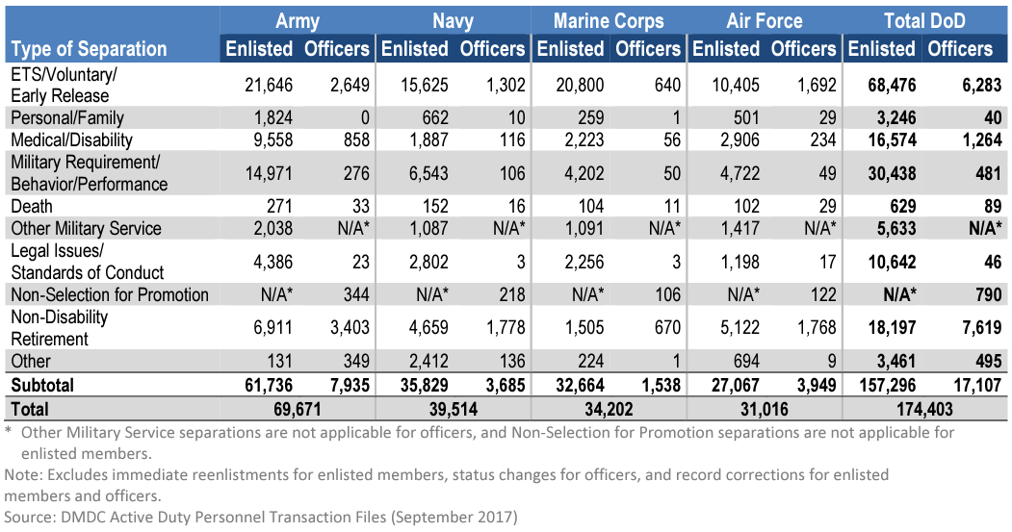
11x more separations for enlisted than officers
43.5% of total enlisted separations are voluntary
Department of Defense 2017 Demographics Report

Slide 11
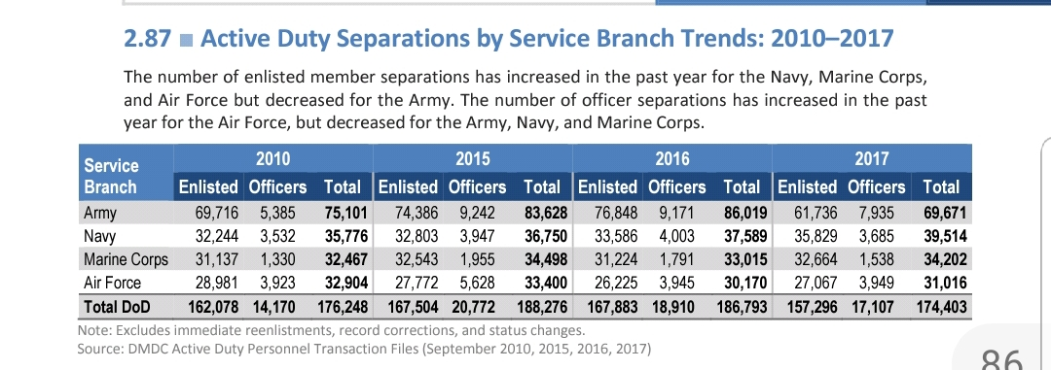
Department of Defense 2017 Demographics Report

Slide 12
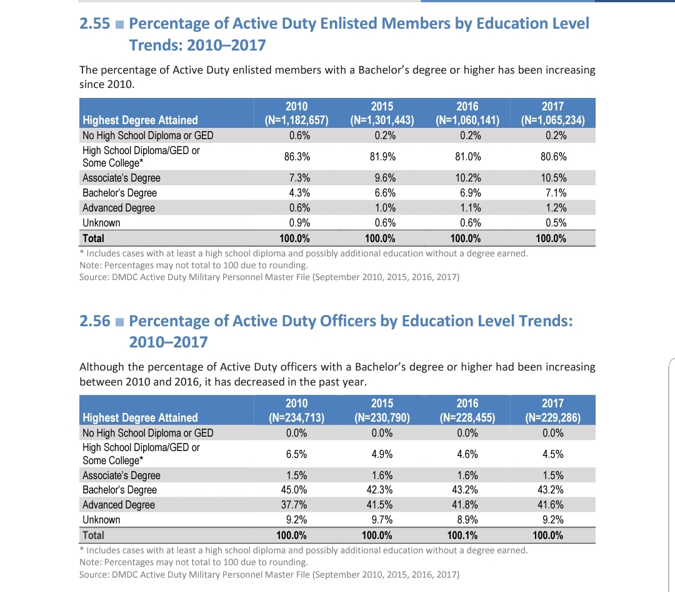
Education Level of Active Duty Members and Officers
Members
Officers
Department of Defense 2017 Demographics Report
Lack of education creates difficulty in getting gainful employment, which leads to increased stress and mental health issues

Slide 13
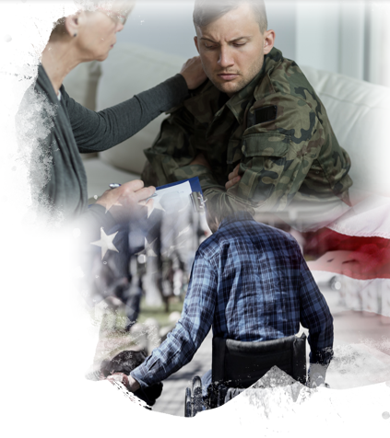
240K+ of veterans with PTSD nationwide in 2017 (1.2M x 20%)
174,403 veterans in the U.S. transitioned in 2017

Slide 14
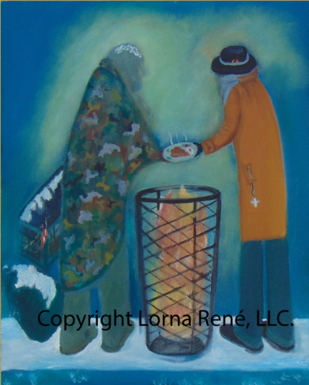
37,800 on a single night in January were homeless veterans in US (VA)
893 of veterans homeless in AZ in 2018 (reported by KTAR News) 970 in 2017

Slide 15


Over 21 million veterans in the US
500K+ veterans in Arizona
370K of veterans unemployed in US (Bureau of Labor Statistics)
29.7K+ veterans unemployed in AZ
162,000 of veterans entrepreneurs in US (Veterans magazine 2017)
47,019 of veterans entrepreneurs in Arizona

Slide 16
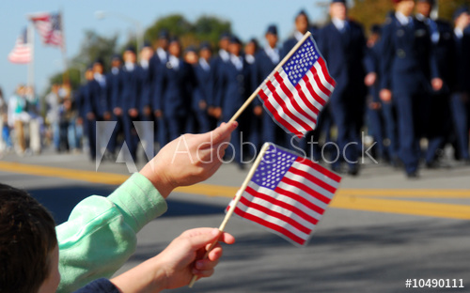
Current Military Transition Process
Soldier until the out-process initiation
Terminal Leave - Up to 90 days
On base organizations
i. Psychologists
ii. Transportation

Slide 17
Common Issues With Transition
Cultural and Behavioral Norms
  The Job Interview
    Unrelatable
    Serious stance – perceived as threatening
  Military Jargon
    Too Easy - Confidence vs. Arrogance
Inadequate preparation for transition
  CQ shifts prior to out processing
  Leadership mentality
    “you’ll have the rest of your life to figure it out”

Slide 18
Common Issues With Transition
OTHER RISKS FOR MILITARY UNIT
Unmotivated soldiers decrease unit efficiency and performance
Units need people prepared for combat not the living room
Tell training story of last unit prior to deployment
Train as you fight

Slide 19
MARKET READY IDEA
HB 2093 12 VBC (Veteran Benefits Counselors)
Proof that we need more assistance for veterans with benefits
To add 12 more VBC’s
Still below needed amount
Transition Units Theory Speech results
Almost 40K views, 10K reactions, 1.5 shares

Slide 20
How Transition Units Theory is the solution

Slide 21
The Transition Units Theory will assist soldiers with:
1. Assistance for civilian life planning
2. Assistance with plan execution
3. Networking and connecting with others, both for professional and personal development
4. Develop the habits and resources needed to maintain a well balanced civilian life
Similar to a basic training concept except for transitioning

Slide 22

BENEFITS
Release service member of military responsibility
Increase efficiency in military units
Remove unfocused people out of the unit
Provide military units with actual numbers for retention
Eliminate waste of funds for purchase of gear for individuals leaving military service

Slide 23
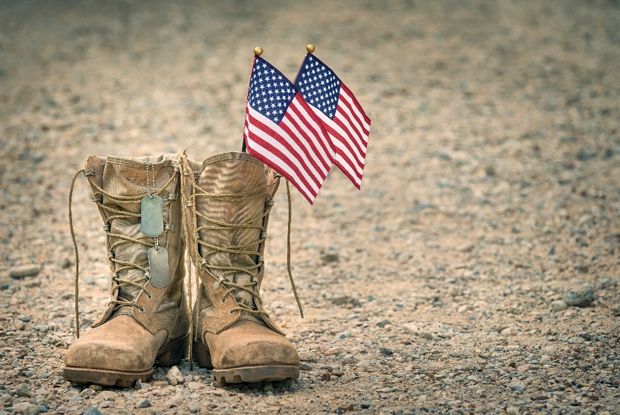
Soldier
Qualifications
Easy Qualification Standards
Honorable discharge
3-6 months prior to military contract ending

Slide 24
A Key Strategy
Partnerships with nonprofits specific to veteran causes
  E.g. Wings for warriors, honor house, United American Veterans
Remain in contact after service

Slide 25

funding

Slide 26

FUNDING SOURCE
Reallocating funds from uniform policy change
New uniform policy
Deployment spending – unnecessary additional uniforms
Fixed Spending for Class A, Multi-cam, Physical Training

Slide 27
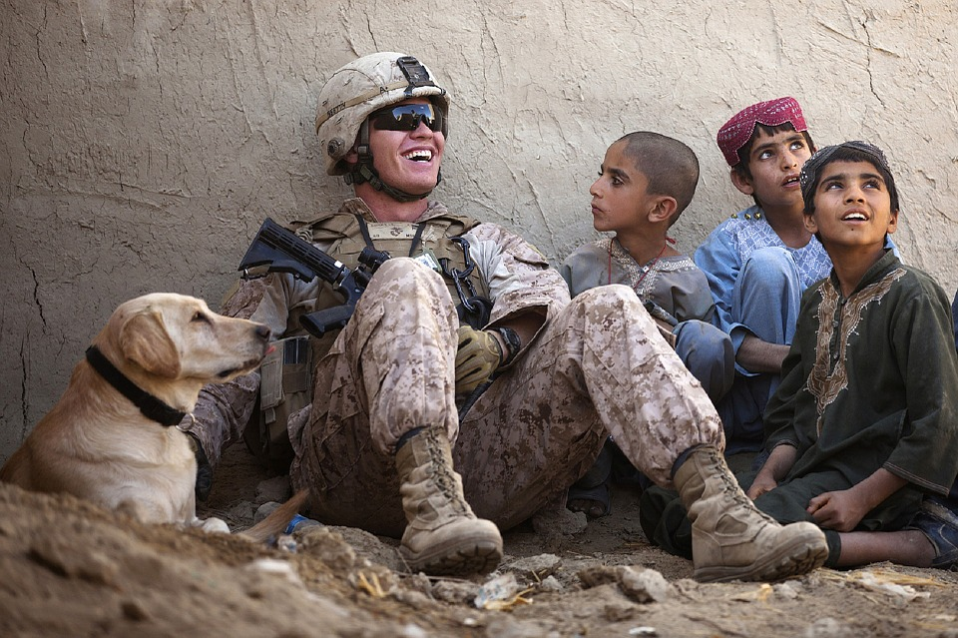
MULTI-CAMS
ARMY CURRENTLY SPENDS
Cost per Unit
  Top - $70
  Trousers - $45
  Patrol Cap - $30
  Boots - $145
Requirements: 3 tops, 3 trousers, 3 patrol caps, 2 pairs of boots
x 3 = $210
x 3 = $135
x 3 = $90
x 2 = $290
TOTAL COST PER SOLDIER
$725
According to the US Defense Department, the average mean of soldiers exited the Army, from 2015-2017 is 79,772
79,772 x 725= $5.7M+ in 1 year
Over 3 years, $173.5M+
Over 10 years, $578.3M+
ARMY REQUIREMENTS

Slide 28
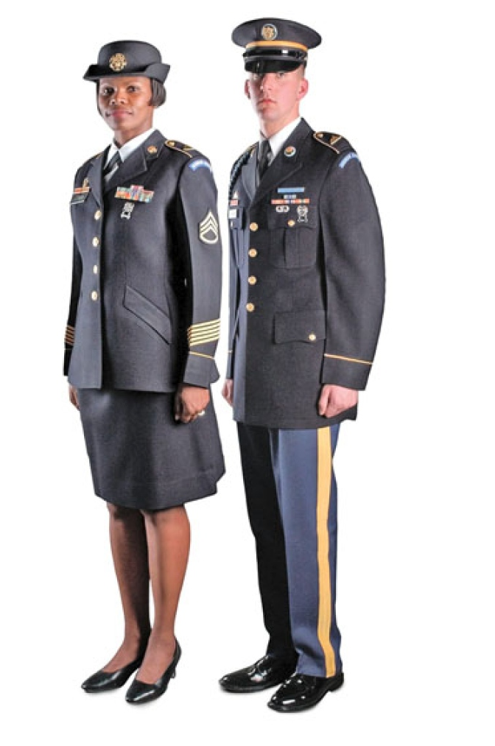
Class A Uniforms
Class A uniform is an estimated $500 per person
If 79,772 people on average exit military from 2017 (Defense Department 2017)
Money spent on unneeded uniforms in one year
  79,772 x 500 = $39.8M+
Over 3 years, $119.7M+
Over 10 years, $398.8M+

Slide 29

Physical Training Uniforms
ARMY CURRENTLY SPENDS
Requirements per soldier: 2 jackets, 2 pants, 3 shorts, 3 t-shirts
  Jacket $52 (2) = $104
  Pants $32 (2) = $64
  Shorts $17 (3) = $51
  T-shirts $5 (3) = $15
Total per service member: $234
79,772 = average service members exit military
$234 x 79,772 = $18.6M in one year
$55.9M+ over 3 years
$186.6M+ over 10 years

Slide 30
$1.16B+ saved from Class A, Multi-cam, and APFT uniforms over 10 years
Imagine if we did the same for all of the branches of service?
E.g. The Marines, Navy, Air Force, Coast Guard
Does not include supplemental garments such as undershirts, ear and eye protection

Slide 31
Military Budget
Current
1. $733B (The Hill)
President Trump
A. Proposing a 2.4% increase for 2019
B. $750B budget (The Hill)

Slide 32
Budget Comparison
$1.16 B
$733 B

Slide 33
Money Saved
In Millions $

Slide 34
Opportunities for Contributions from the State
SBA (Certified Woman Business)
  Available for Federal Contracting
State and Federal art grants (NEA)
  Innovation art program for veterans
Opportunity Zones/Hubzones
  Contract veteran businesses and nonprofits with the transition
  47,019 of veterans entrepreneurs in AZ
Transition Units Theory program
  Savings from military budget
  10% of military savings to Lorna René LLC for Marketing and Awareness

Slide 35
Nonprofit Fundraising
Veterans and anyone can donate towards nonprofits programs
Fundraising Opportunities
a. Art prints as a gift for galas in ticket pricing
b. Wholesale pricing of prints from Lorna René LLC to nonprofits
c. Nonprofits make profit from art prints sales to be utilized for their cause

Slide 36

MARKETING AND AWARENESS

Slide 37

Honor Our Heroes series
Lorna René LLC
Official event supported by State of Arizona
Year over year awareness of veteran causes
Provide opportunities for various cities
  i.e. City of Scottsdale, next year City of Peoria, etc.
Creates opportunities for veteran population to
network with nonprofits
Art Therapy

Slide 38
Honor Our Heroes series
Lorna René LLC (cont.)
Tourist attraction
  Gift Shops and boutiques sell art prints at retail
Create opportunities for politicians and community leaders to discuss veteran issues with the veteran community
Honor 100K+ veterans
Budget to fund Transition Units Theory marketing
Fund Honor Our Heroes series

Slide 39

Today's Challenge
Create a bill to utilize state resources to properly invest in the transition of our nations heroes.
Join with us in our efforts to save our Veterans!

Slide 40


Contact Information
Cornelius J. Maxwell
General Director, Lorna René LLC
720-452-1211
LornaReneFineArt.com
LaMaxMarketing.com

